Slide 1



Tech details

Slide 2

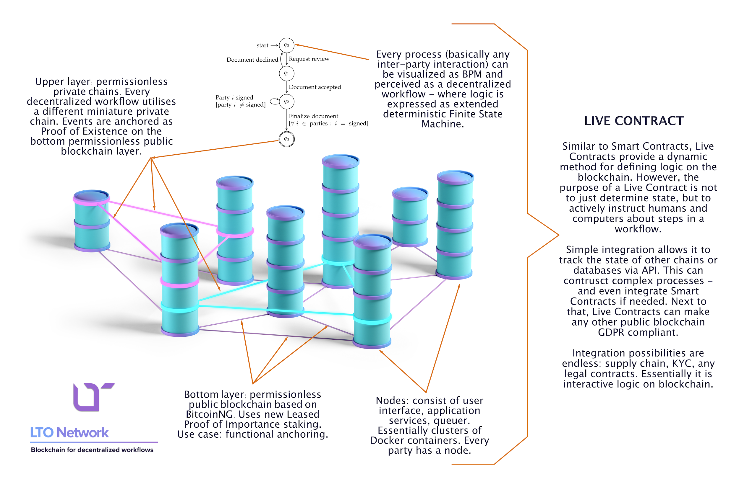
LTO Network - Quick overview

Slide 3


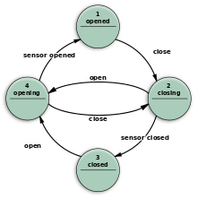


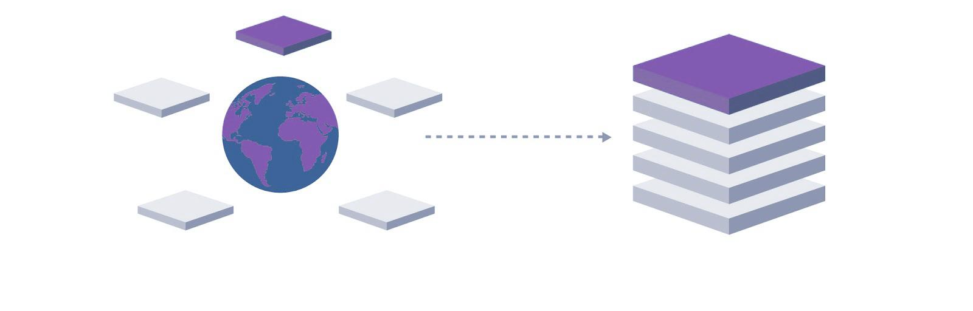
Solving the problems of permissionless private chains
Live Contract
Event chain
Genesis block
Interactions with the Live Contract
Block hash anchoring tx in public chain

Slide 4
Setting up a node
Requirements
Docker
Internet connection
Setup
Change settings in ‘docker-composer.yml’ e.g. your port (optionally)
run docker-compose up
Goto http://localhost:3000

Slide 5
LTO Node Concepts
The LTO Node has 3 concepts you need to understand:
Scenario
Event Chain
Process

Slide 6
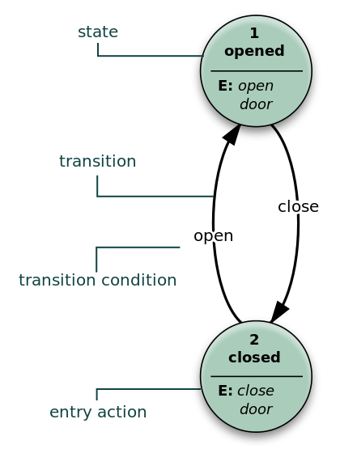
LTO Node Concepts - Scenario
A scenario is described using a Finite State Machine
Live Contract

Slide 7
LTO Node Concepts - Event Chain
Event Chain stores 3 concepts:
Events, the actual event on the chain.
Identities, who is allowed to interact with the chain
Resources, which resources are linked to the chain. Resources can be things like scenarios, processes, documents, etc.
Event chain

Slide 8
LTO Node Concepts - Process
Process is an instantiated scenario. It describes:
current state
possible future states
past actions
actors who can interact with the process
data stored in the process in the form of assets

Slide 9
Building a workflow scenario (docs)
Deterministic concepts
In order for workflow to work decentralized all the concepts need to be deterministic. To make these concepts deterministic we use 2 important concepts:
JSON Schema: every concept within a scenario or event chain needs to be described using a json schema. (docs)
Deterministic Resource Identifiers: every resource used within a process needs to have a unique a reproducible id. (docs)
Notes:
Resource Iden

Slide 10
Building a workflow scenario or live contract (docs)
A scenario is made up out the following concepts:
actors: who performing which action (docs)
state: in which states can process be (docs)
action: which actions can be performed to lead to a new state (docs)
normal action (docs)
http trigger (docs)
nop trigger (docs)
event trigger (docs)
custom trigger (docs)
asset: Data to be stored in the process (docs)

Slide 11
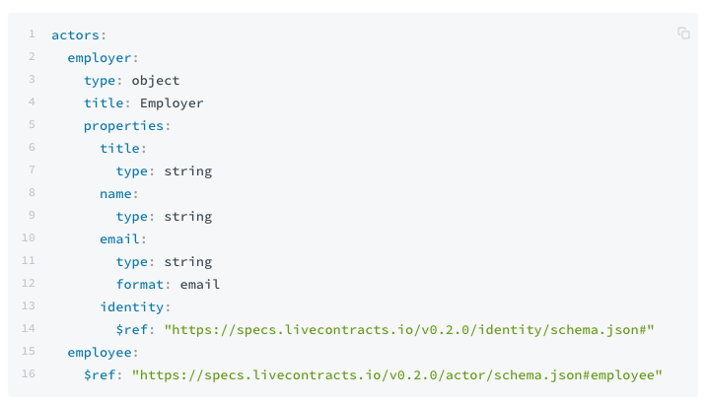
Workflow concepts - Actor
Items in the actors property of the scenario aren't actor objects, but JSON schemas defining the properties available for the actor once instantiated in the process.
The custom schema for actors should extend the basic actor schema, which means it must at least have a title and identity and property.

Slide 12
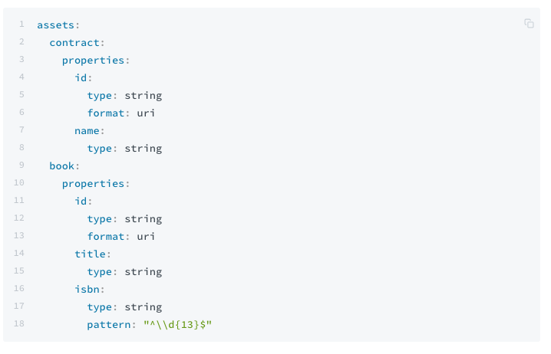
Workflow concepts - Asset
Items in the assets property of the scenario aren't asset objects, but JSON schemas defining the properties available for the asset once instantiated in the process.
‌
Assets don't have any required properties, but it's common for an asset to have a title property. If this property exist, it's copied from the JSON schema.

Slide 13
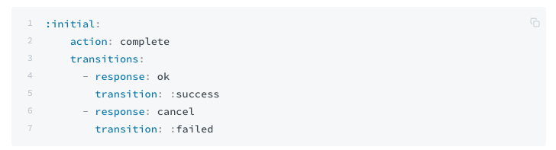
Workflow concepts - State
All the possible states are described in the states section. Each state describes through which action it can transition to a new state.

Slide 14
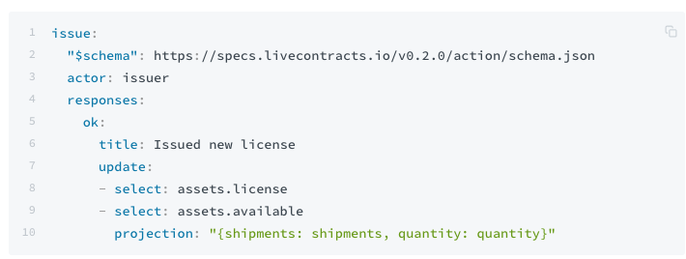
Workflow concepts - Action
An action is something that can be performed by actor or the node of an actor. An action may trigger a state transition and / or may update the process projection.
There are 2 different action types:
Normal action: performed by receiving a response event.
Triggered action: performed are performed by the node itself. There are 3 types of trigger:
Event trigger
HTTP trigger
NOP trigger

Slide 15
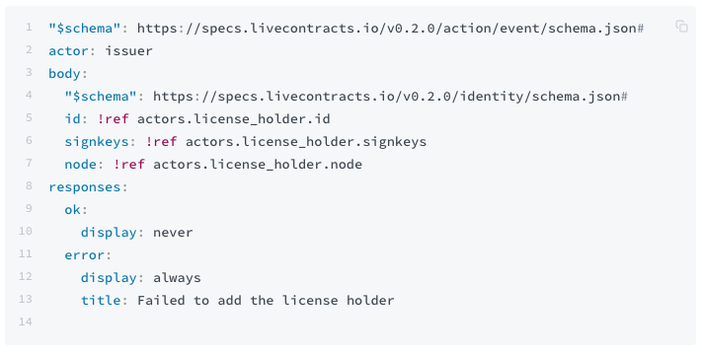
Workflow concepts - Action - Event Trigger
With an event trigger action the node itself will add an event to chain and sign it with the private key of the node itself.
Example

Slide 16
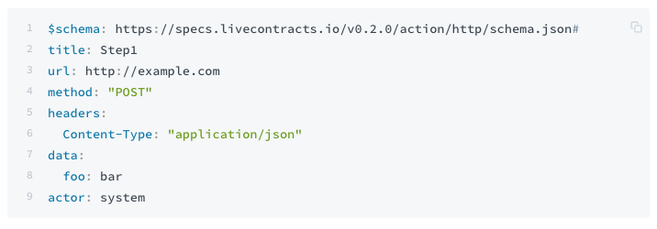
Workflow concepts - Action - HTTP Trigger
An HTTP trigger will send an http request to a configured url
Example

Slide 17
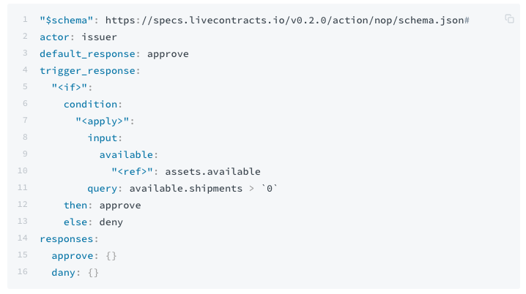
Workflow concepts - Action - NOP Trigger
No operation (NOP) trigger is able to manipulate data within the process. So it allows you to update asset or actors information.
Example

Slide 18
Interacting with the Live Contract
Interaction with the process is done through the event chain. So if an actor wants to respond to an action he needs to add an event to the chain and send the chain to the node.
Starting a process is done through a certain set of events.
Instantiation
An identity event of the initiator of the process is added. This way the initiator is able to added new events to chain.
The scenario event is added to the chain, so the node can instantiate the scenario. If the scenario is already stored through an other event this event can be skipped.
Initialization
A process event is then added to the initialize the scenario.
Now that the process has be initialized the first response event can be added to the chain to perform the first action.
Start
Send in the first response to your workflow to jump to the next state.

Slide 19
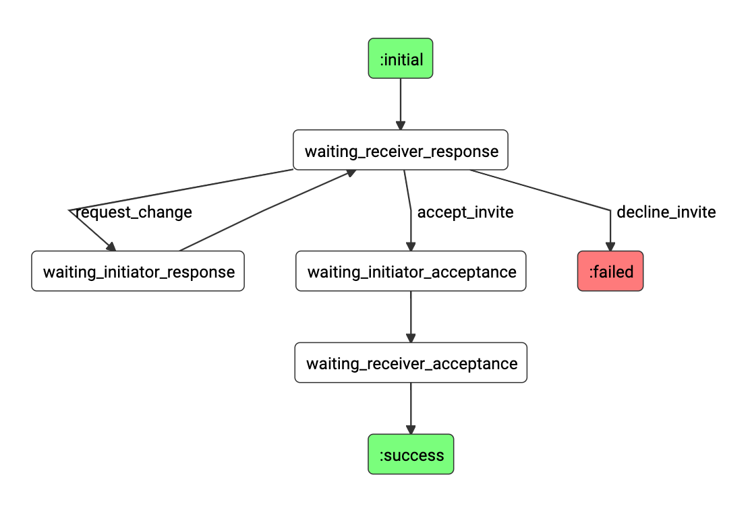
Building a workflow
Today's assignment
Build a simple NDA workflow, where 2 individuals agree on not disclosing a specified piece of information.
FSM:

Slide 20
Building a workflow - tools
In this github repository you will find: https://github.com/legalthings/lto-deepdive
docker-compose.yml to run your node
Bootstrap code that will help build the workflow
this presentation for reference
Documentation you can find here: https://docs.livecontracts.io

